Slide 1
Algorithm for Rerouting
Initialize network topology
Set default controller
Check the network connection
for switch=1 to range(N)
Exchange heartbeat(hello) messages
Detect the failed link, if a packet is dropped
Update the routing tables
Notify the controller
//handle link failures
In switch N //N denotes the link failed switch
Store the dropped packet in the switch
Store the other packets that reach the Nth switch meanwhile
The stored packets are in compressed state
for switch 1 to N
Invoke neighbour nodes
Check the routing table and trace the alternate path
the stored packets are sent to destination using fast rerouting
6. Repeat the steps 4 and 5 for failure free topology

Slide 2
Proposed Work Flow Diagram
Feed in the network topology
Future packets are sent via the alternate path till the link is restored
Test the links using hello messages
Stored packets are sent using fast rerouting
In case of failed link , store the packet in nearby switch
Stored packets are compressed in state

Slide 3
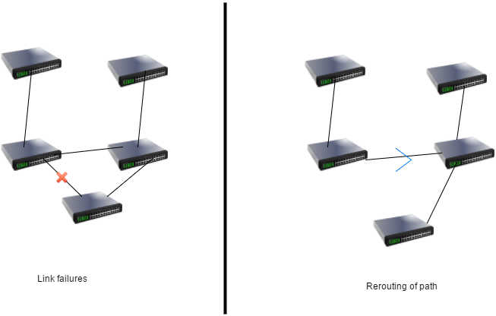
Link failure Discovery

Slide 4
Modules of the Project
Detection of link failure.
Storing of dropped packets in compression state.
Handling the failed link using the alternate back path.
Stored packets are sent using fast rerouting technique.

